Slide 1
Introduction to Cyber Security
Module 1

Slide 2

Definition of Cyber Security
It encompasses technologies, processes, and practices designed to safeguard against unauthorized access, data breaches, and other cyber threats.
Cyber security refers to the practice of protecting systems, networks, and data from digital attacks.
Cybersecurity is the ongoing effort to protect individuals, organizations and governments from digital attacks by protecting networked systems and data from unauthorized use or harm.

Slide 3
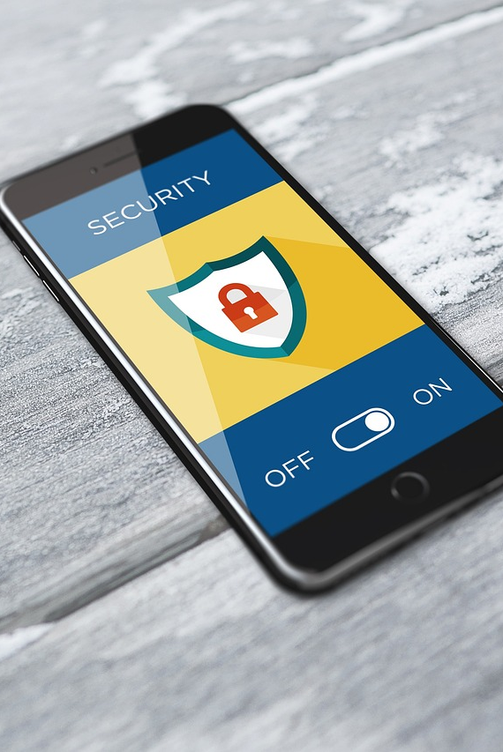
Importance of Cyber Security
In today's interconnected world, cyber security is crucial for protecting sensitive information, ensuring privacy, and maintaining the integrity of digital assets.
Cyber attacks can have severe consequences, including financial loss, reputational damage, and legal liabilities.

Slide 4

Scope of Cyber Security
It involves protecting not only computers and networks but also mobile devices, IoT devices, and cloud-based systems.
Cyber security encompasses various domains, including network security, information security, application security, and more.

Slide 5
Tools We use For Hacking
Kali Linux
Kali Linux is a dedicated Linux distribution designed for penetration testing and security research. It features a comprehensive suite of tools for tasks like network analysis and vulnerability scanning, and it supports a wide range of devices including desktops and ARM-based devices like the Raspberry Pi.
Termux
Termux is an Android app that offers a Linux terminal environment with extensive package management capabilities. It allows users to install and run a variety of programming languages and tools directly on their Android devices without needing root access. Termux also provides access to Android functions via the API, like sending SMS or accessing location services.
Also using tools like Zphisher is more successful on termux than Kali linux
Overall
both Kali Linux and Termux provide specialized tools and environments tailored to different platforms (desktop and mobile, respectively) for advanced technical operations, particularly in programming and cybersecurity.

Slide 6
Protecting Your Personal Data
Personal data is any information that can be used to identify you, and it can exist both offline and online.
Many people think that if they don’t have any social media or online accounts set up, then they don’t have an online identity. This is not the case. If you use the web, you have an online identity.
Offline Identity
Your offline identity is the real-life persona that you present on a daily basis at home, at school or at work. As a result,
family and friends know details about your personal life, including your full name, age and address.
It's important not to overlook the importance of securing your offline identity. Identity thieves can easily steal your data from right under your nose when you're not looking!
Online identity
Your online identity is not just a name. It's who you are and how you present yourself to others online. It includes the
usermame or alias you use for your online accounts, as well as the social identity you establish and portray on online
communities and websites.
You should take care to limit the amount of personal information you reveal through your online identity.

Slide 7
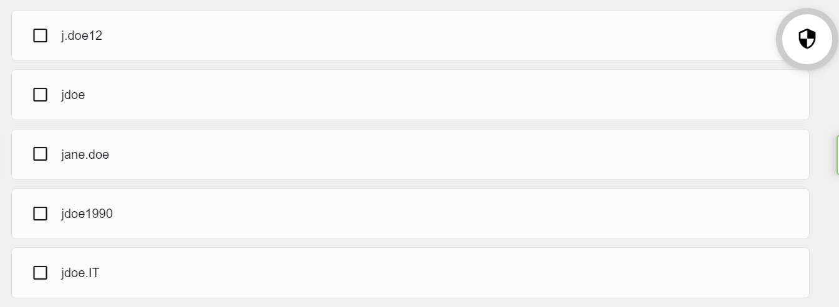
Your Online Identity
It’s your first day on the job, and it’s time to choose a username for your online identity. Which of the following options would you choose?

Slide 8
Your Data
Personal data describes any information about you, including your name, social security number, driver license number, date and place of birth, your mother’s maiden name, and even pictures or messages that you exchange with family and friends.
Cybercriminals can use this sensitive information to identify and impersonate you, infringing on your privacy and potentially causing serious damage to your reputation.
Smart Devices
Consider how often you use your computing devices to access your personal data. Unless you have chosen to receive paper statements, you probably access digital copies of bank account statements via your bank’s website. And when paying a bill, it’s highly likely that you’ve transferred the required funds via a mobile banking app.
But besides allowing you to access your information, computing devices can now also generate information about you.
Wearable technologies such as smartwatches and activity trackers collect your data for clinical research, patient health monitoring, and fitness and wellbeing tracking. As the global fitness tracker market grows, so also does the risk to your personal data.

Slide 9
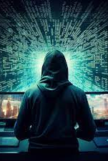
It might seem that information available online is free. But is privacy the price we pay for this digital convenience?
For example, social media companies generate the majority of their income by selling targeted advertising based on customer data that has been mined using algorithms or formulas.
Of course, these companies will argue that they are not ‘selling’ customer data, but ‘sharing’ customer data with their marketing partners.

Slide 10
What Do Hackers Want?
So, with all this information about you available online, what do hackers want? Of course, they want your money.
QUIZ TWO
1. Can you think of an example that you have experienced yourself or that you have heard or read about, where cybercriminals have accessed or tried to access financial information online?
2. What do hackers really want and why do they want it ?

Slide 11
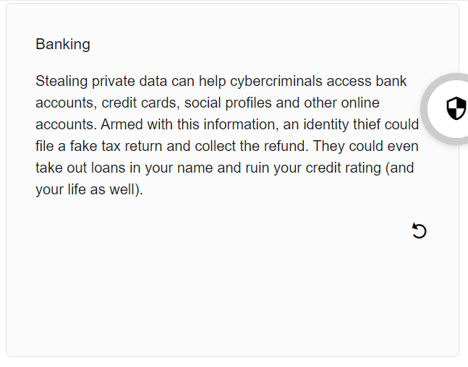
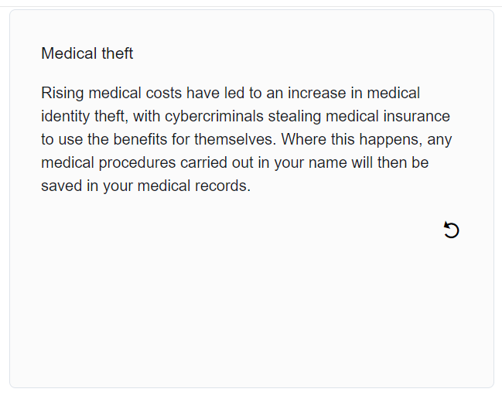
Identity Theft
Not content with stealing your money for short-term financial gain, cybercriminals are invested in the long-term gain of identity theft.
Cybercriminals are certainly very imaginative when it comes to gaining access to your money. But that’s not all they are after — they could also steal your identity and ruin your life.

Slide 12
Who Else Wants My Data?
ISP: Your ISP tracks your online activity and, in some countries, they can sell this data to advertisers for a profit.
In certain circumstances, ISPs may be legally required to share your information with government surveillance agencies or authorities.
Advertisers: Targeted advertising is part of the Internet experience. Advertisers monitor and track your online activities such as shopping habits and personal preferences and send targeted ads your way.
Social Media / Websites: These platforms gather information about your gender, geolocation, phone number and political and religious ideologies based on your search histories and online identity. This information is then sold to advertisers for a profit.
Websites use cookies to track your activities in order to provide a more personalized experience. But this leaves a data trail that is linked to your online identity that can often end up in the hands of advertis

Slide 13
Thank you for your time 😊

Slide 14
Next Lesson 😊 > Types of Hackers > Organizational Data

